Slide 1
Idea Presentation
Md. Muktadir Rahman(1305097)
Partha Chakraborty(1305117)

Slide 2
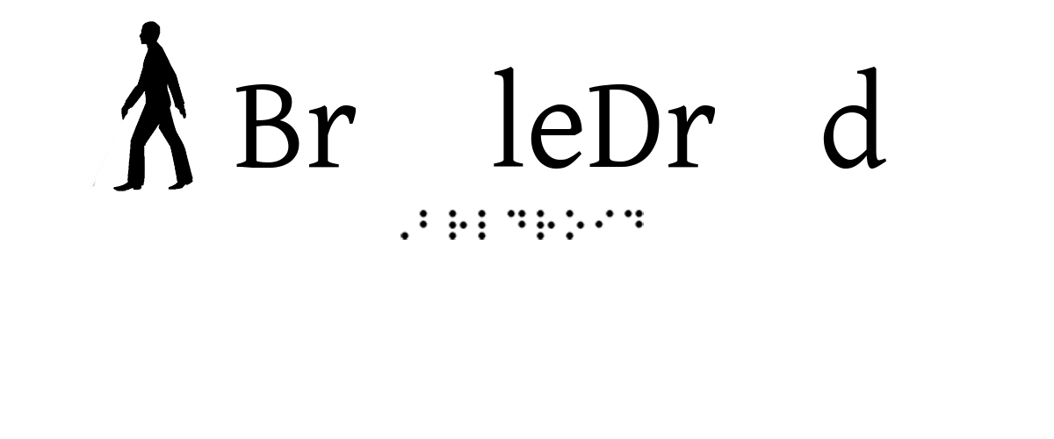

Slide 3
What is Brailledroid?
Brailledroid is a hardware interface designed for visually impaired person to use smartphone.

Slide 4



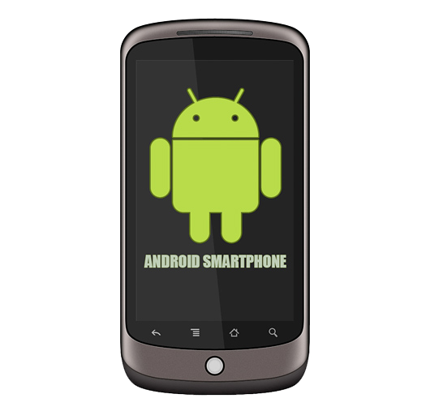

Slide 5
What brailledroid offers?
Users can –
Make a call
Send messages
Receive call

Slide 6
Challenges
Lack of suitable braille keyboard.
Bluetooth pairing with android smartphone
Parsing the exact command

Slide 7
Actuators
Bluetooth (HC-05)
Matrix keypad-(4x4)
Buzzer

Slide 8
Outcome of Project
A user friendly braille interface for android smartphone
Later this project can be extended for bidirectional interaction between visually impaired persons and smartphone.

Slide 9
Maze Runner

Slide 10
What is Maze Runner ?
Maze runner is a maze game.
Depicts the unsolved maze of Old academic building (OAB) of BUET

Slide 11
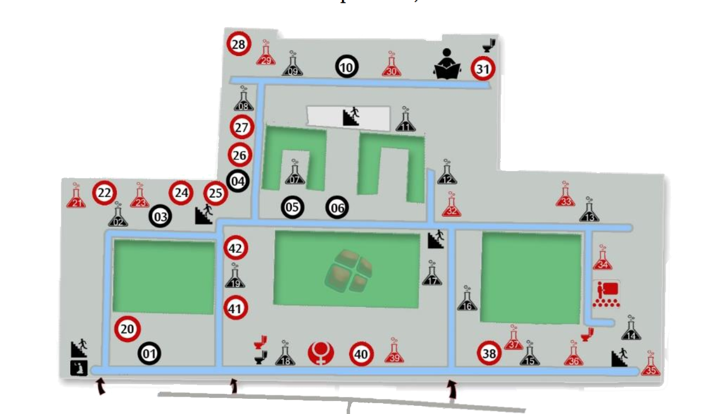
You may be accustomed with the map.

Slide 12
But scenario changed
You have to get out of the building in less then two minutes(if you fail you will be assigned an OS offline)
The guards are shutting down and opening get after certain interval
You have to control the game by tilting board

Slide 13
Sensors and Actuators
Sensors
Gyroscope-(6 DOF)
Actuators
LED Matrix
LCD Display/Seven Segment display
Buzzer

Slide 14
Outcome of Project
Joy of playing Game
Newbies in BUET will be accustomed with OAB maze

Slide 15
DX ball

Slide 16
DX ball
It is normal DX ball game
Except that you have to control the game by tilting board.

Slide 17
Sensors and Actuators
Sensors
Gyroscope-(6 DOF)/Tilt sensor(AT407)
Actuators
LED Matrix
Seven Segment display

Slide 18
Outcome of Project
Joy of playing Game

